Slide 1



Slide 2
Hibernate Framework
Hibernate is a Java framework that simplifies the development of Java application to interact with the database.
Hibernate is the best, ORM Framework for Java.
It is an open source, lightweight, ORM (Object Relational Mapping) Tool.
Hibernate implements the specifications of JPA (Java Persistence API) for data persistence.
Hibernate internally uses the JDBC API to interact with the database.
Hibernate simplifies the data creation , data manipulation and data access.
It is programming technique that maps the object to the data stored in the database [CRUD].

Slide 3


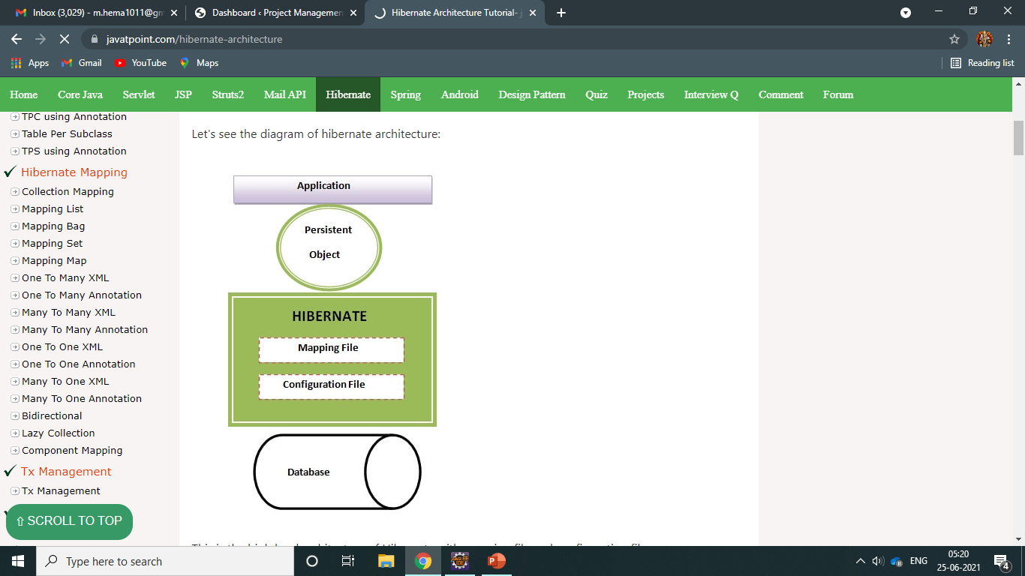
Architecture

Slide 4
Hibernate Architecture
Elements of Hibernate Architecture
SessionFactory
Session
Transaction
ConnectionProvider
TransactionFactory.
The Hibernate architecture includes many objects such as persistent object, session factory, transaction factory, connection factory, session, transaction etc.
The Hibernate architecture is categorized in four layers.
Java application layer
Hibernate framework layer
Backhand api layer
Database layer

Slide 5
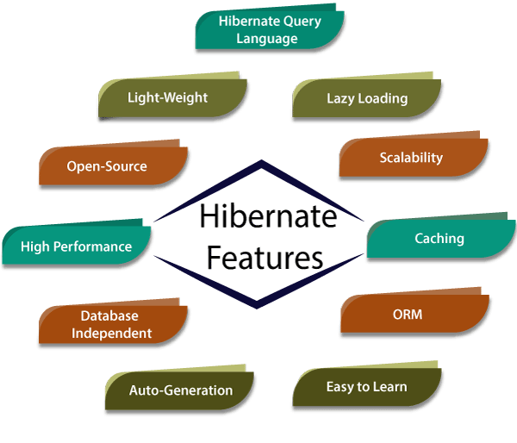

Slide 6
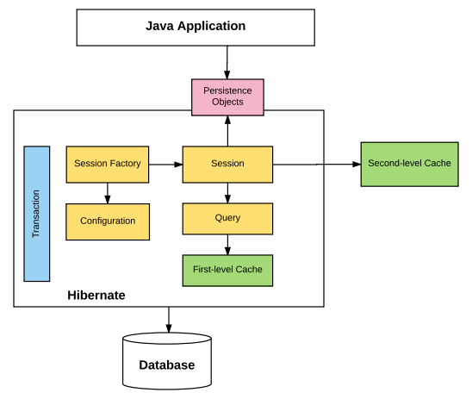
Flow of Hibernate

Slide 7
JDBC Connectivity
RDBMS
JDBC SQL SERVER, MySQL
(Persistence)
APP(IDE) Database
JAVA APPLICATION
Db
Java Database Connectivity

Slide 8
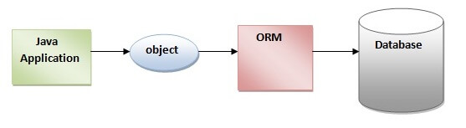
ORM Tool Connectivity

Slide 9
WHAT IS ORM?
ORM (Object Relational Mapping) it is the tool for persisting the Data’s.
Storing all data’s in database called “Persistence”.
Normally we connect both Java Application with Database called “JDBC”.ORM tool will create data’s without accessing/writing any queries in database.[CRUD Operations]
Data can be in variable, object, primitive values like int, string, float, double, or the data are in Object format.
Like Eg: Student Table

Slide 10
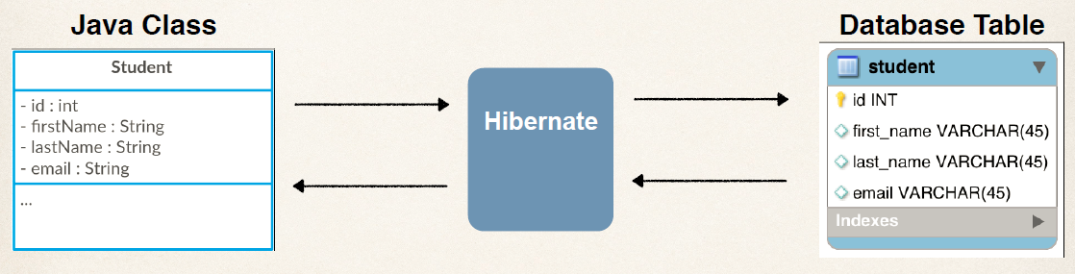
Example

Slide 11
How it Works?
If we create Student Table : class Student { (one Object) ,it stores 4 values in Db.
int id; Every Object contains some Data’s.
String firstName;
String lastName;
String email;
}
So without accessing SQL query we can save the data’s by using the Method: save(obj);
Here we can directly store the data inside database by using this Method .
Then how we will convert Object into Table ?
So here is the concept called ORM , by using this ORM tool it contains –Object , Relational , Mapping

Slide 12
How its Possible from Object to Table?
If we talk about the class structure and it should be same as Table structure.
class has a Table and Object is your Rows.(2 rows, with 2 obj).
So that means we are trying to create an Relationship between Object Oriented Programming concept.
It is the possible with the help of ORM concept we use here.
Object(Java concept) , Relational(Database concept) , Mapping(we need to map it).
id | firstName | lastName | email
101 | Raj | kumar | raj@gmail.com
102 | Priya | dharshini | priya198@gmail.com

Slide 13
What is the Use of Hibernate?
By using Hibernate we can store your Objects into your Database directly with the help of using the Method called: save(obj);
How we use this same method for all ?
So we need to create an Object called , Session/Session Object as,
s.save(obj);

Slide 14
How do we create Session?
For that we need to create an Object of Session Factory under that we can create Session.
In Session Factory we need to provide those details to configuration for database.
When we working with JDBC , we have to provide certain steps Driver Name , specify the database URL , Username and Password in the configuration file , so that we can load inside the Session Factory Object.
So , there are multiple ways for configuration like: 1. XML
2. Java Configuration.
Once we got an session Factory Object , we can work with Session & by using Session we can save the Object -> s.save(obj); not only save we can also use get(); method to fetch the data.
So we can use all this concept to implement the hibernate and also ORM Tool.
session . save(book);

Slide 15
How to implement Hibernate
Use any IDE: Eclipse, Netbeans , IntelliJ.
In eclipse IDE, we can create Maven Project because the advantage of using an maven project it will give you a Project Structure.
For hibernate we must use some certain libraries , we need to download those libraries and we add it .
Install Hibernate configuration tool Help->Eclipse Marketplace->search hibernate,
->JBoss Tools->select checkbox->hibernate(uncheck all other options)->click->install->restart eclipse .
Right click on project or resource package->select new->other->search->hibernate->choose->hibernate configuration file ->fill all options ->Finish.
(hibernate.cfg.xml) file will be created.

Slide 16
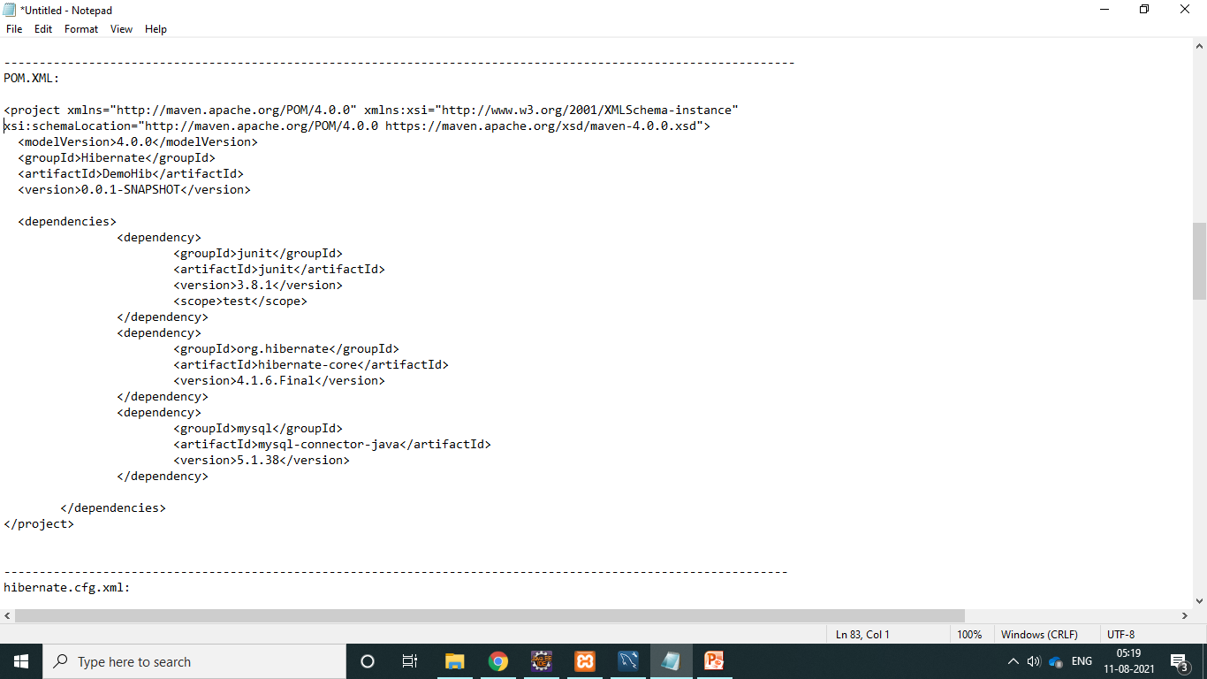
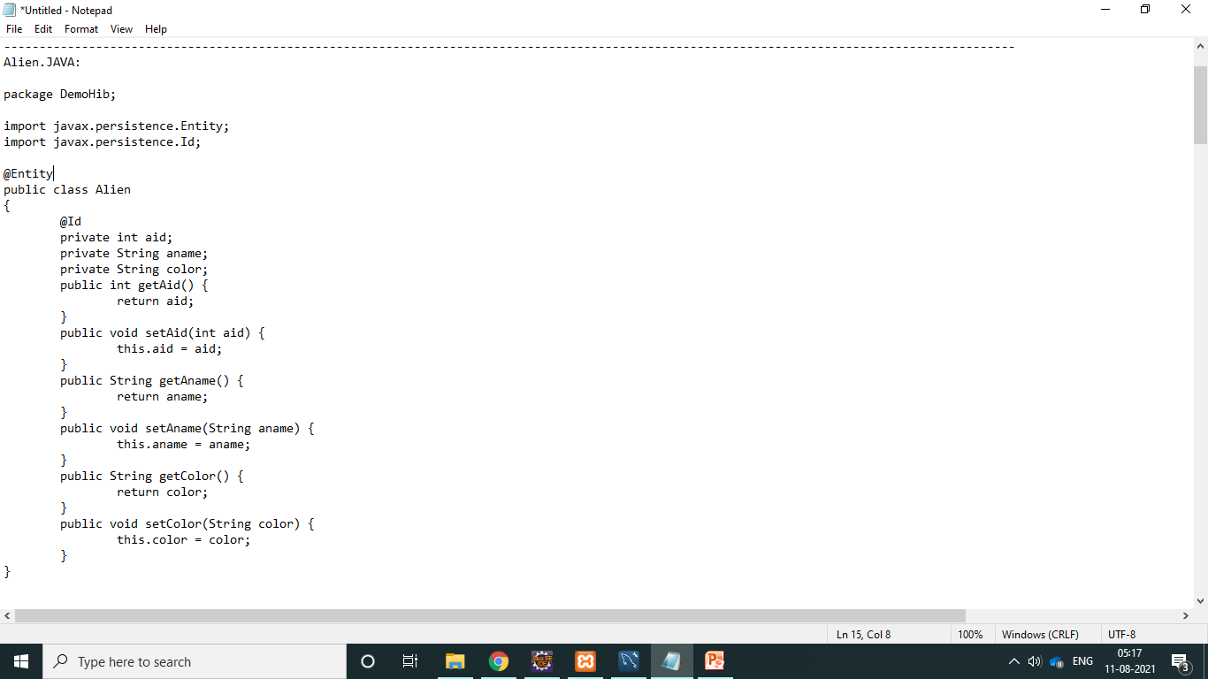
PRACTICAL : 1.Create a Maven project
Pom.xml
Alien.java

Slide 17
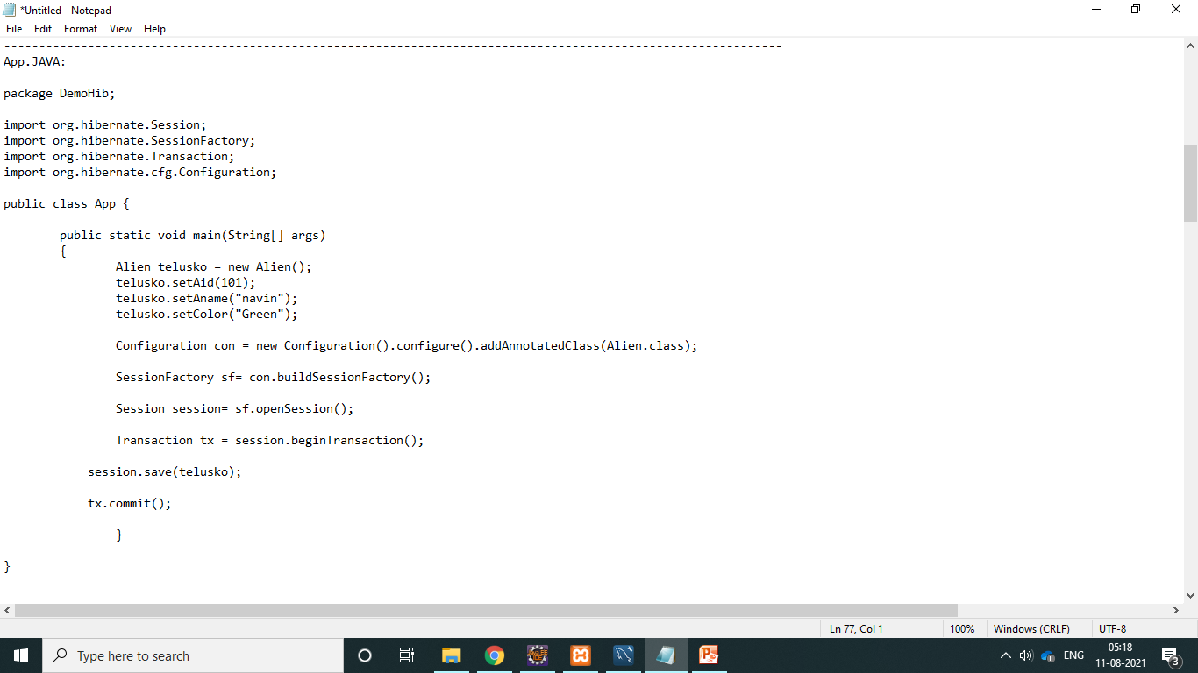
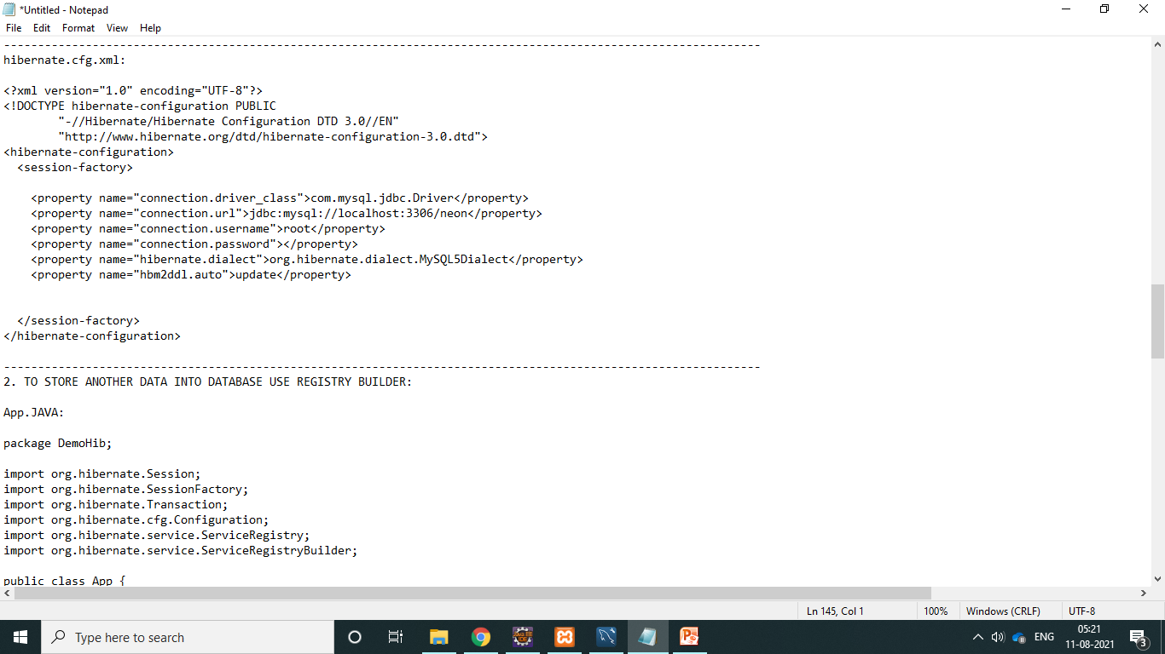
App.java
hibernate.cfg.xml

Slide 18
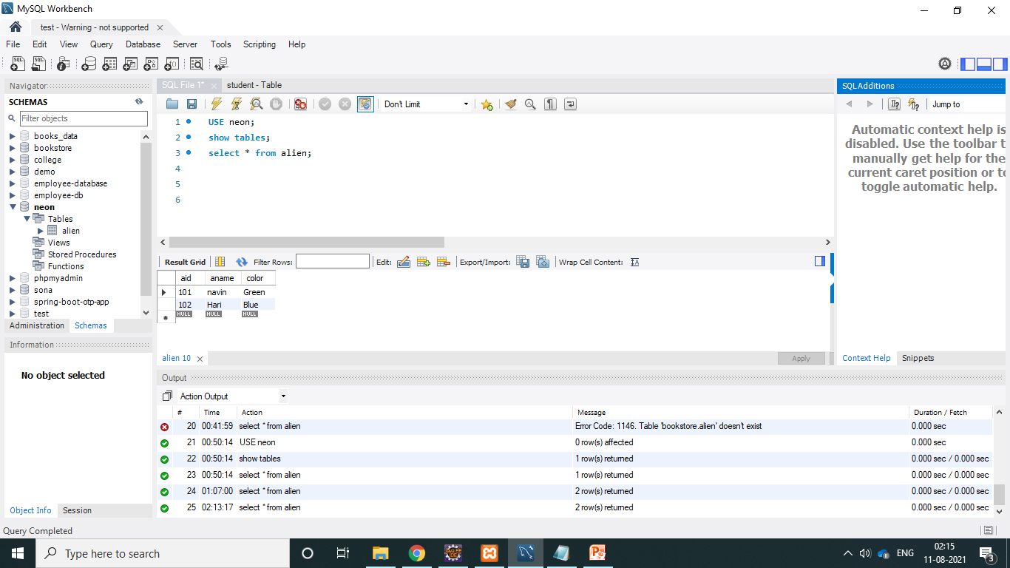
OUTPUT

Slide 19
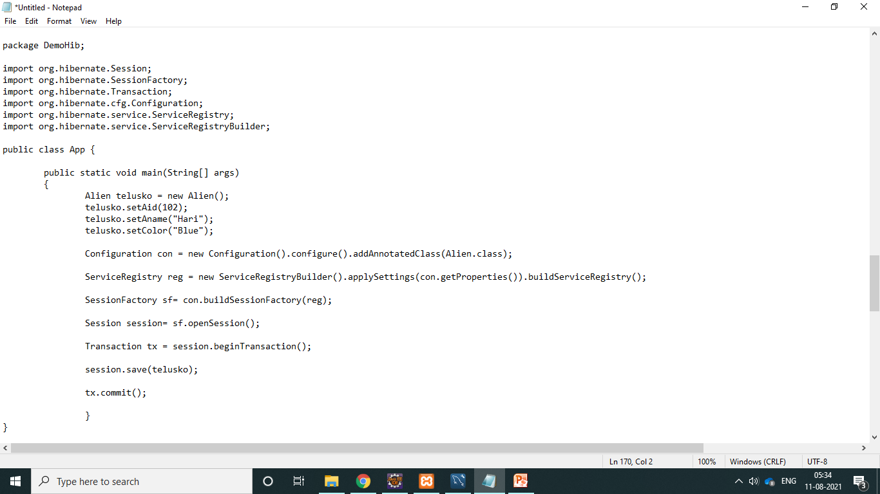
2. RegisteryBuilder : Update TO STORE ANOTHER DATA INTO DATABASE .
App.java

Slide 20
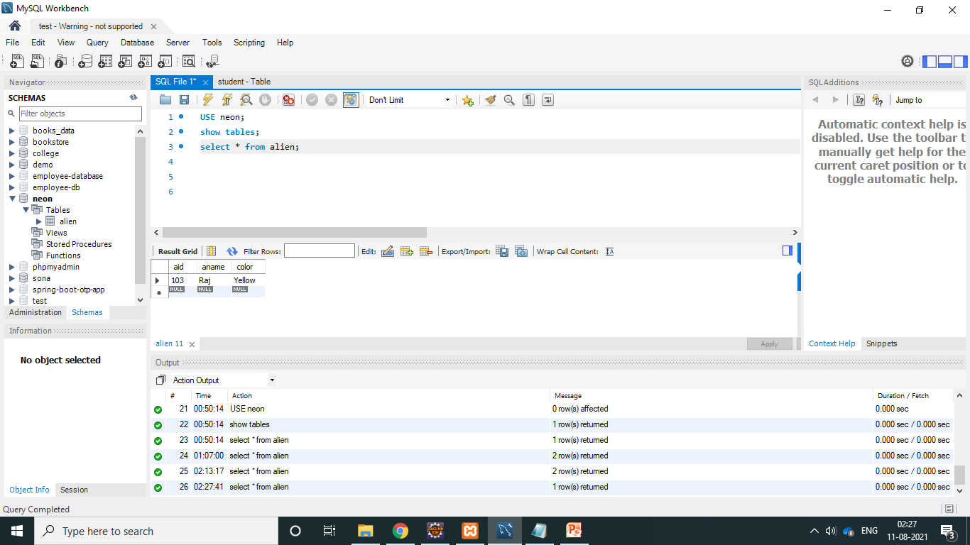
3. Create
<property name="hbm2ddl.auto">create</property>
if we use create here , it will create a new data/table again and again newly. It doesn't show the old data's.
It will drop the old data's/table also.

Slide 21
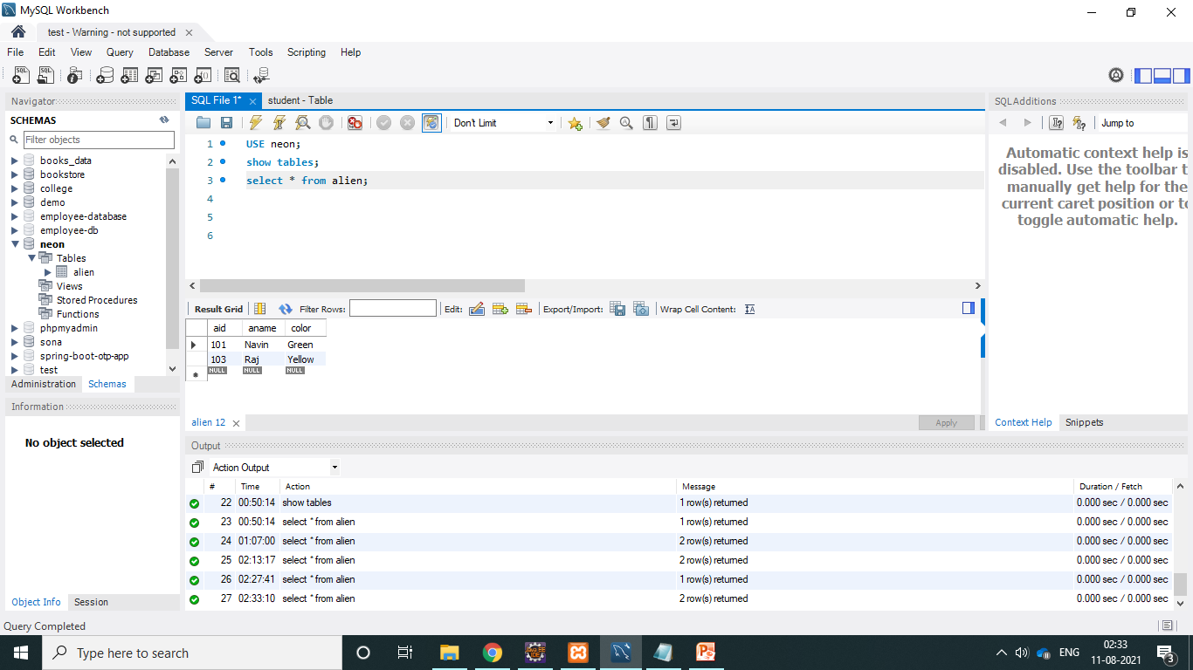
4. SHOW SQL PROPERTY: IN ( hibernate.cfg.xml ) <property name="hbm2ddl.auto">update</property> <property name="show_sql">true</property> -> It will automatically give /you can see the SQL Query while running the project. -> It will give you only the insert query no create/drop queries. -> It is not getting a new table/data every time when, we run this ,we don't want every time it should update in your database again.

Slide 22

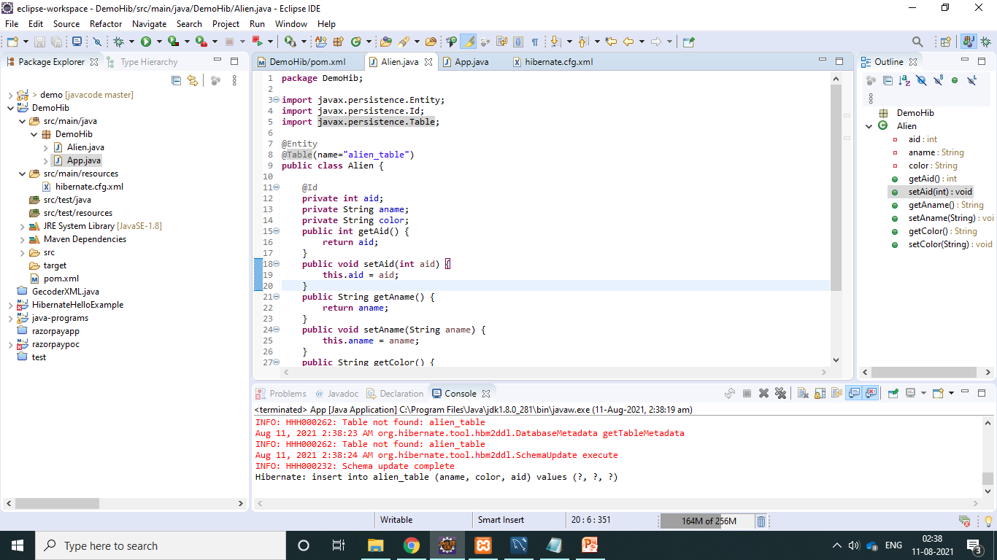

ANNOTATIONS @Entity CREATE @Table
App.java

Slide 23
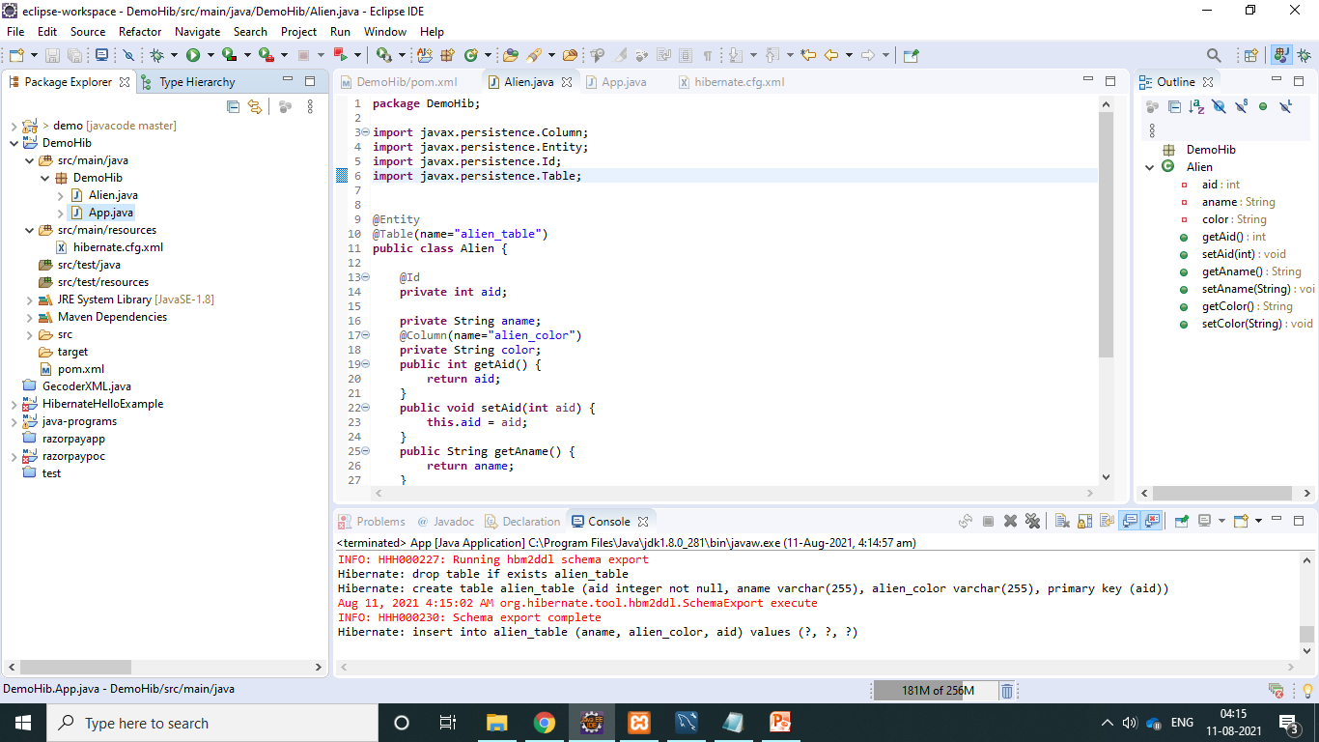
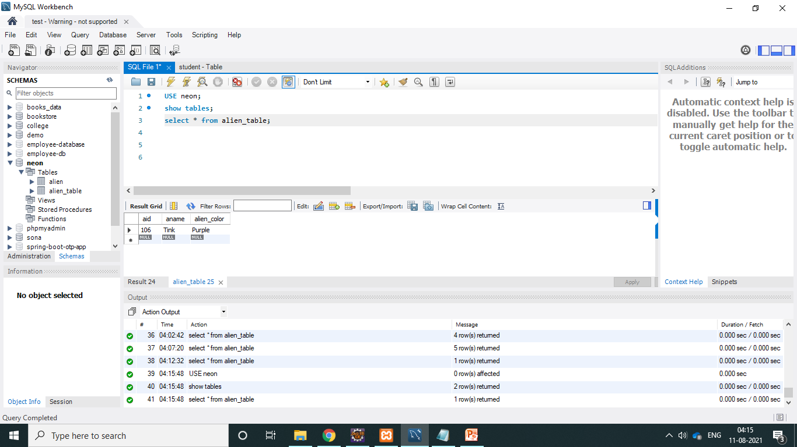
@Column :If you need to change the column name you can use this @Column annotation and you can specify the name(new name), which you need to change it.
App.java
OUTPUT

Slide 24
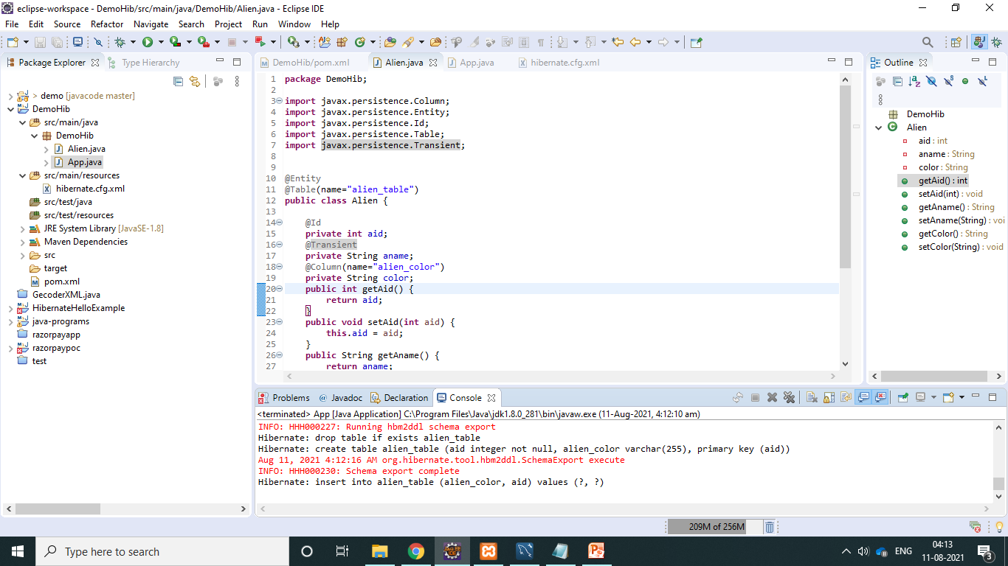

@Transient : It is used to store the temporary data. i.e, it will not be getting stored (aname). it will show only aid and alien_color in the table.
Alien.java
OUTPUT

Slide 25
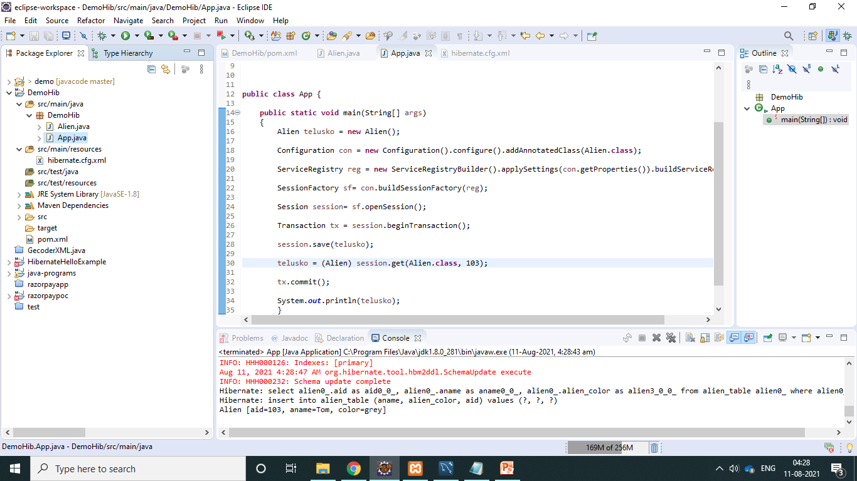
How to Fetch Data from hibernate: UPDATE
App.java

Slide 26
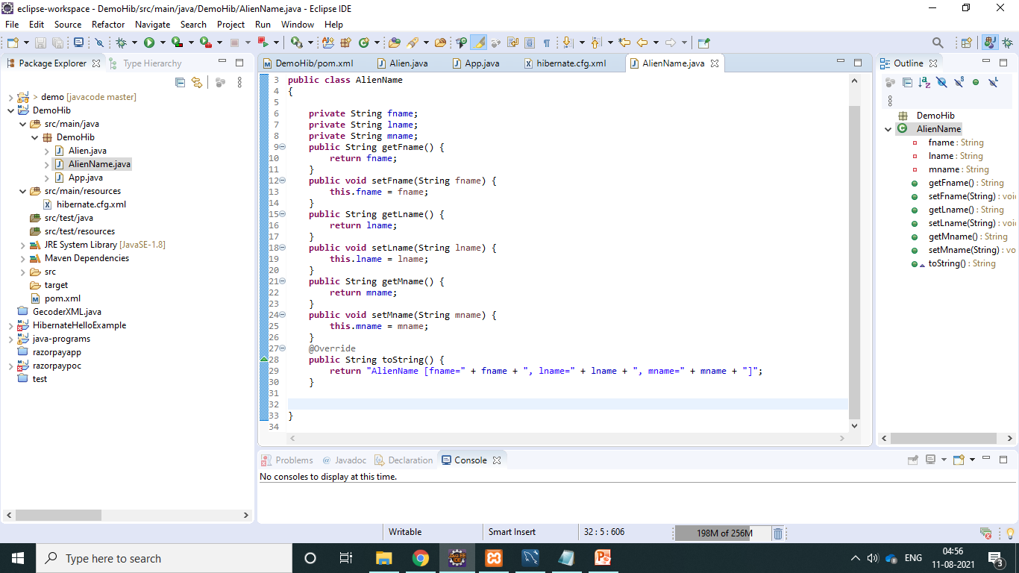
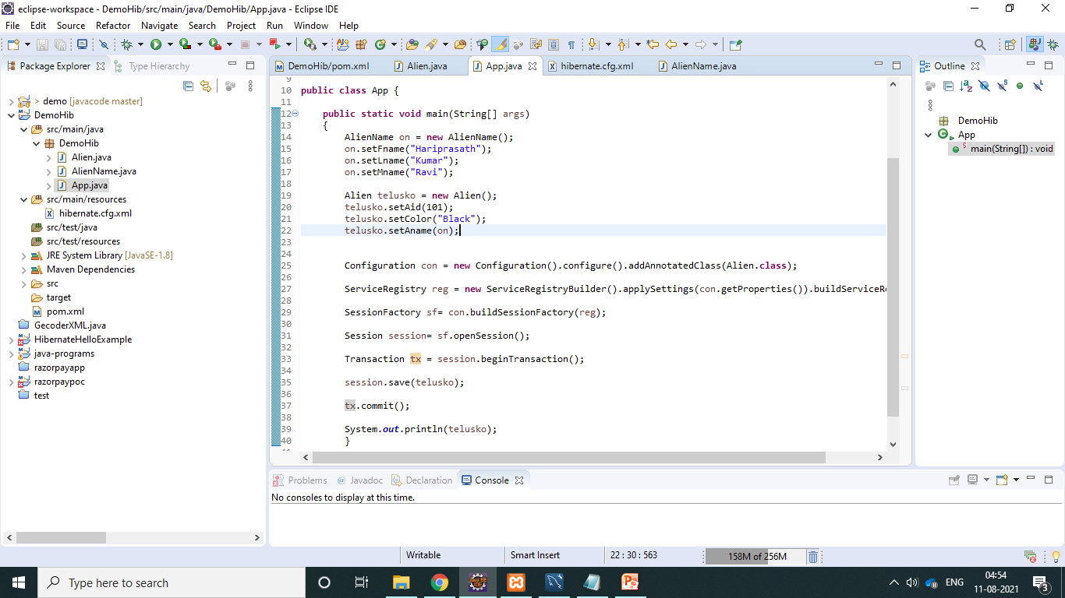
How to use Embeddable Object: CREATE
Alien.java
App.java

Slide 27
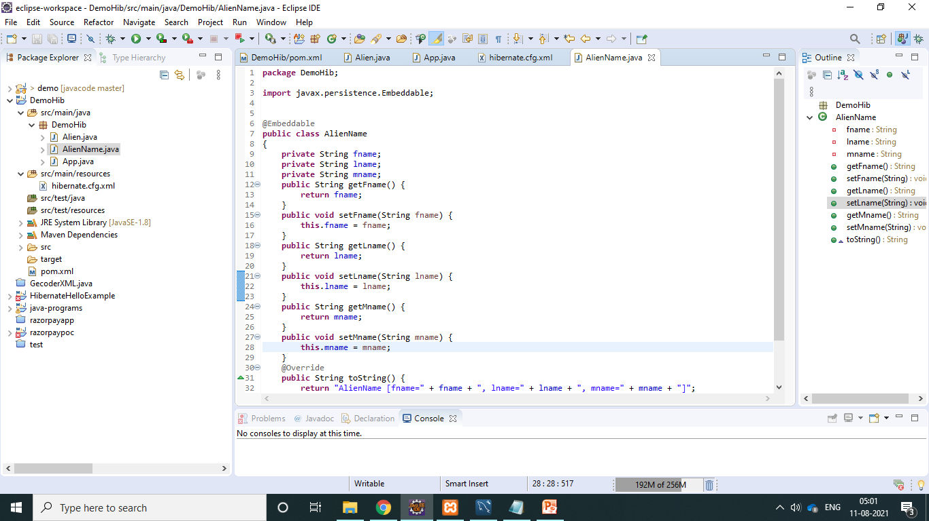
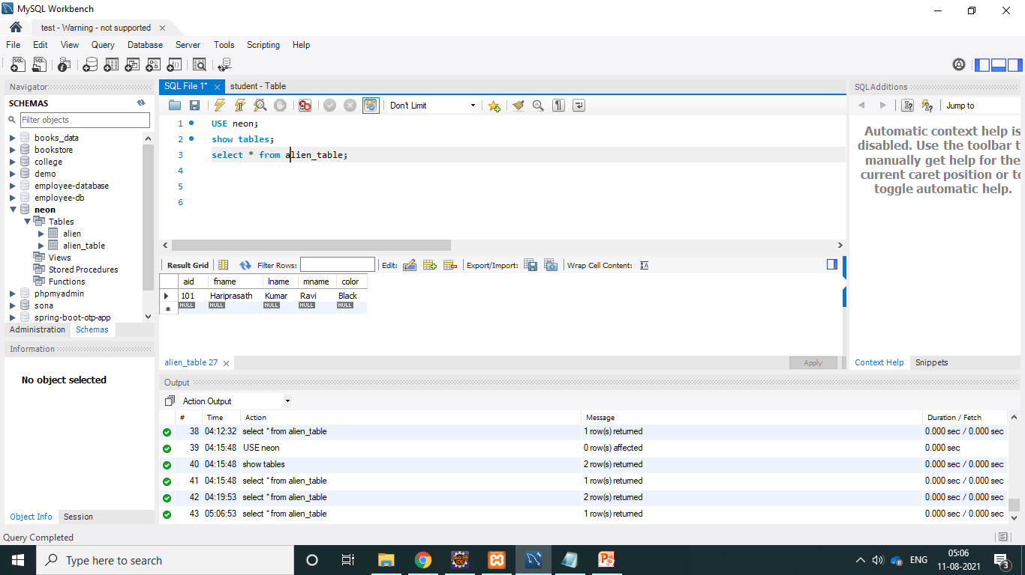
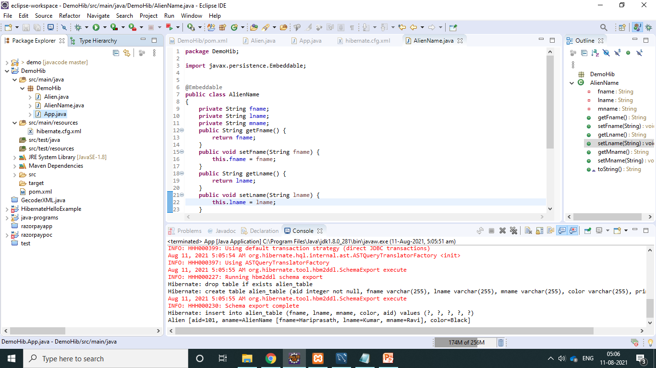
AlienName.java
OUTPUT
Run output

Slide 28
Mapping Relations Theory:
@Entity (Annotation) Laptop ( OneTOOne)
Public class Laptop
{
@Id
Private int lid; (lid - PRIMARY KEY)
Private String lname;
@ManyTOMany
Private student stud; ManyTOMany
------ (Getters and setters )
}
lid | lname
101 | Dell
PRIMARY KEY
lid | lname | Rollno
101 | DELL | 1
102 | HP | 1
102 | MAC BOOK | 2

Slide 29
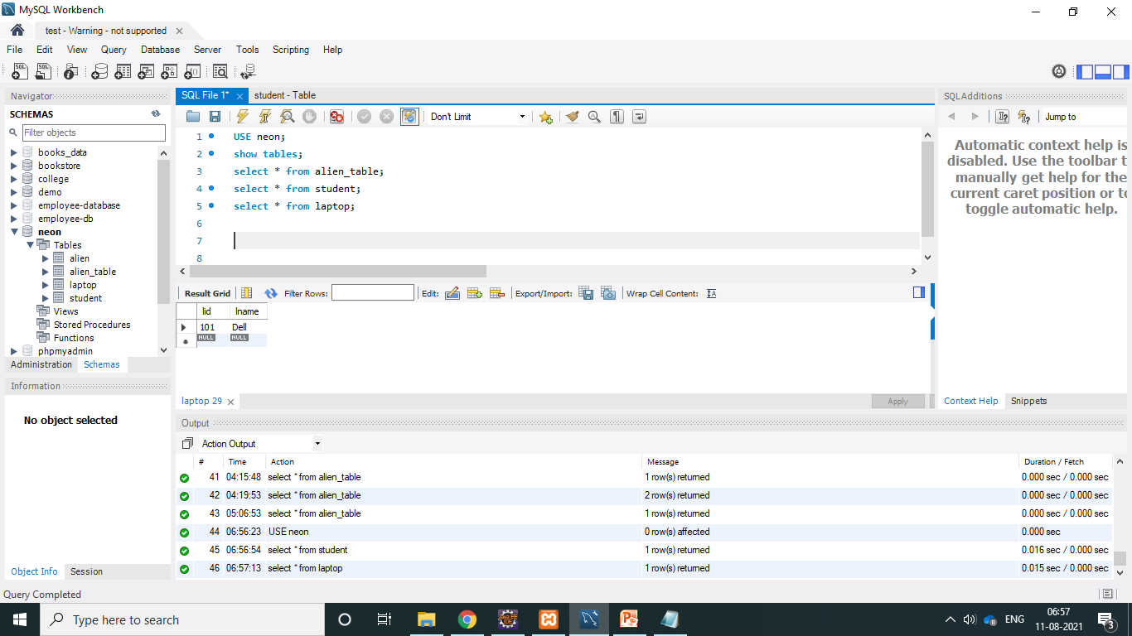
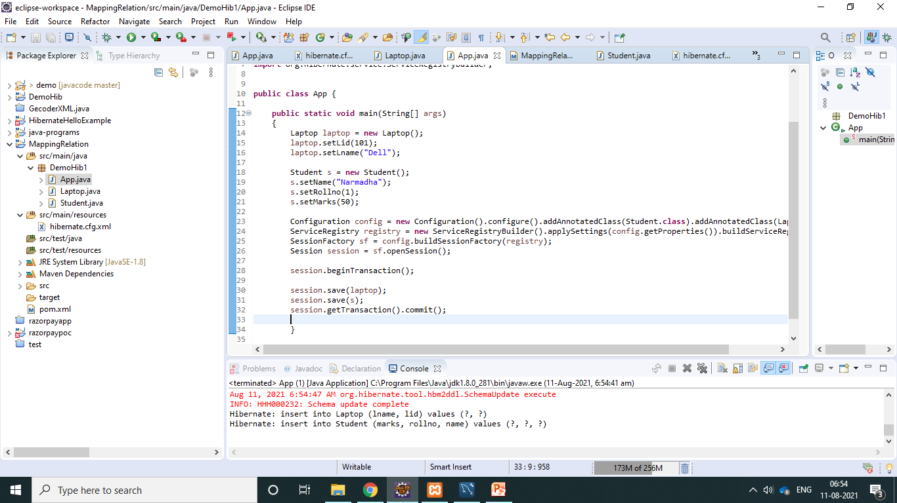


Slide 30
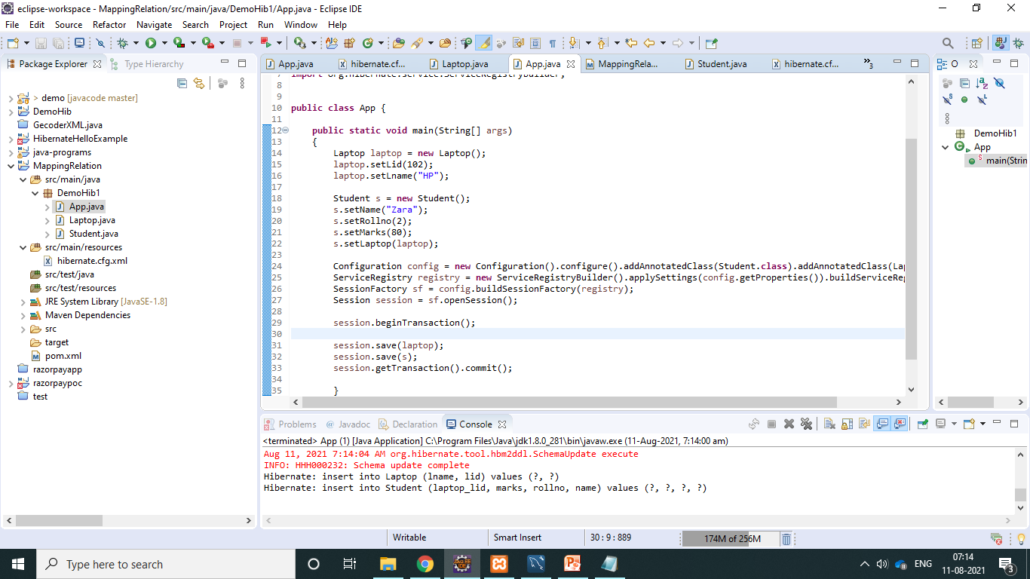

@OneTOOne

Slide 31
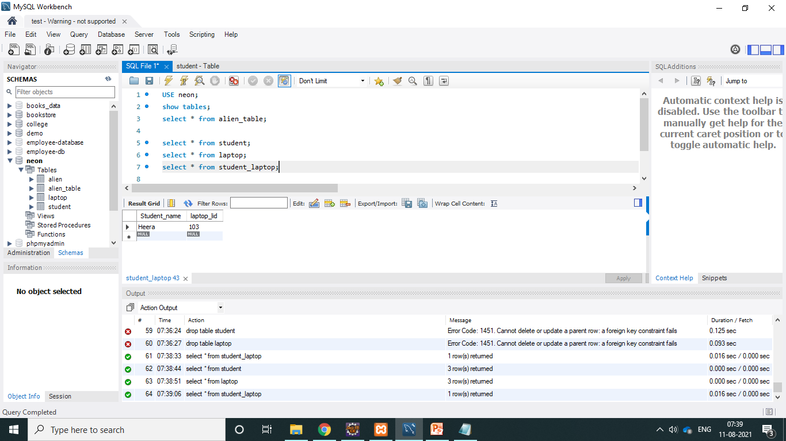
@OneTOMany

Slide 32
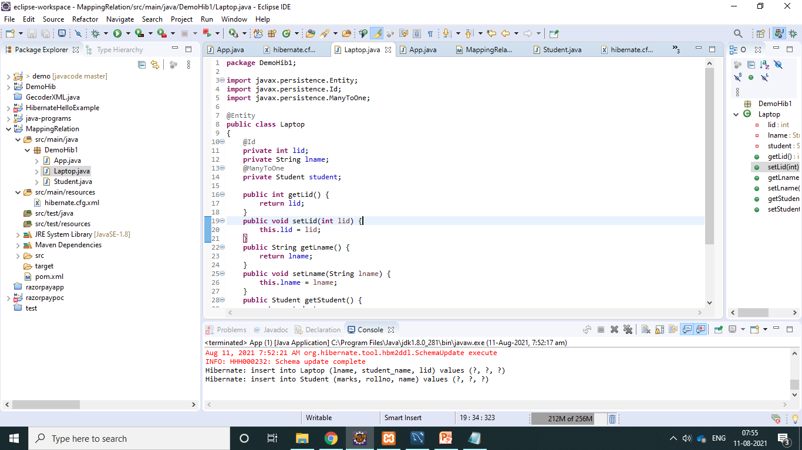
@ManyTOOne

Slide 33
@Entity (Annotation) Student (OneTOOne)
Public class Student
{
@Id
Private int rollno; (rollno - PRIMARY KEY)
Private String name;
Private int marks;
Private int lid; ( lid - FORIEGN KEY )
@OneToOne
Private Laptop laptop ;
or
@OneTOMany (mapped By “stud”)
Private List<Laptop> kaptops ;
-------- (Getters and setters ) ManyTOMany
}
rollno | name | marks | lid
1 | Naveen Redy | 50 | 101
rollno | name | Marks
1 | Naveen | 50
2 | Aarthi | 56

Slide 34
Fetch EAGER and LAZY
Alien.java
@OneTOMany(mappedBy=“alien”,fetch=FetchType.EAGER)
App.java
Alien e1 = session.get(Alien.class, 1);
System.out.println(a1.getAname());

Slide 35
Hibernate Caching
SEND REQUEST
RECEIVE DATA’S
S1 APPLICATION
S2 CACHE MEMEORY
FIRST LEVEL CACHE.
SECOND LEVEL CACHE.
DATABASE
SEVER
CLIENT

Slide 36
HQL(Hibernate QUERY Language)
SQL HQL
Select rollno from student select rollno from student
column table property class

Slide 37
Hibernate Object states /persistence Life cycle
garbage
Transient
new
garbage
garbage
Save();
Persits();
Persistent
Removed
get();
find();
Removed()
detach();
Detached

Slide 38
What is JPA ?
JPA – JAVA PERSISTENCE API.
The importance of JPA is if you want switch from one technology to another tools you can do it very easily using JPA.

Slide 39
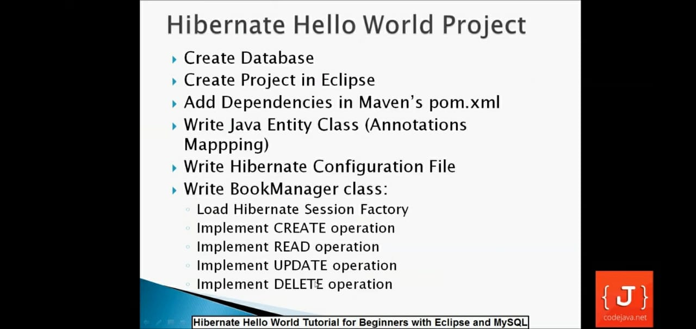
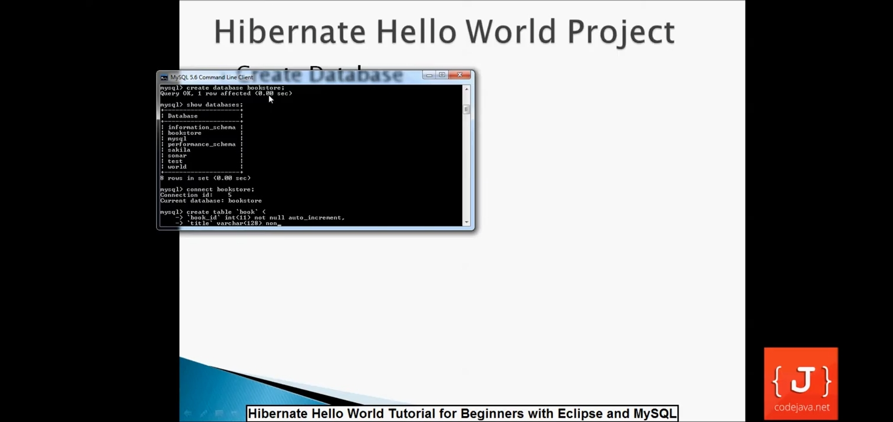
These all the steps to create hibernate maven project
Create database name as: bookstore

Slide 40
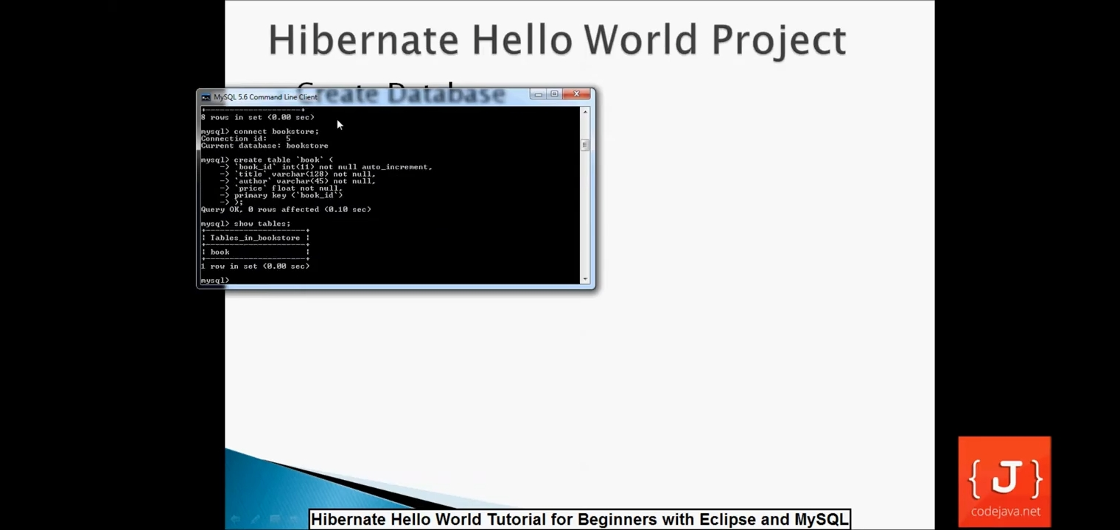
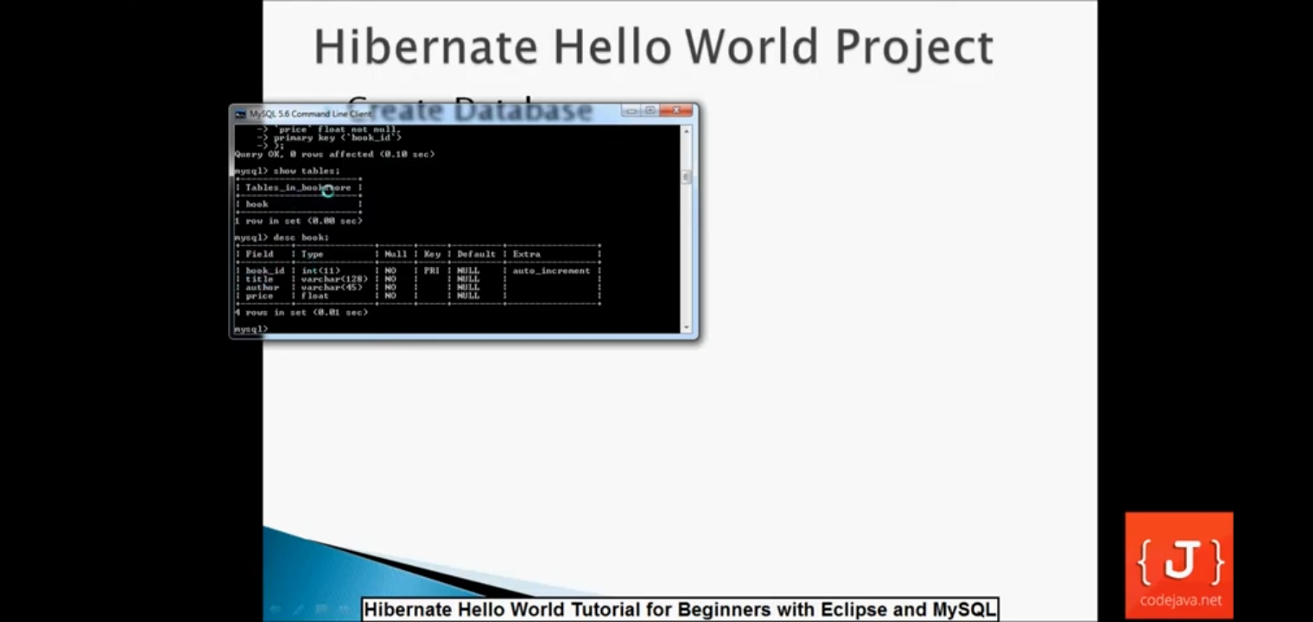
v
Create Table book

Slide 41
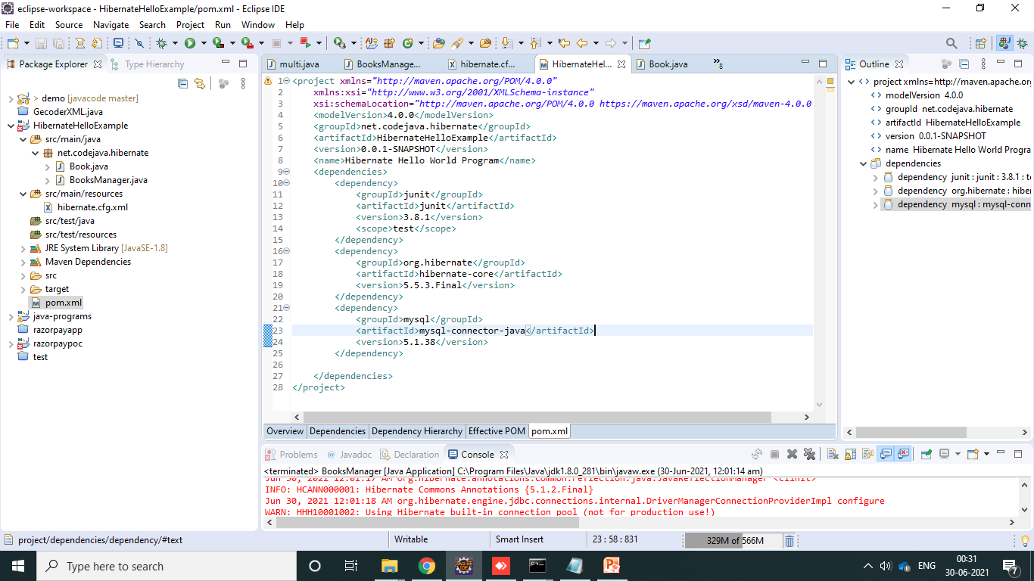
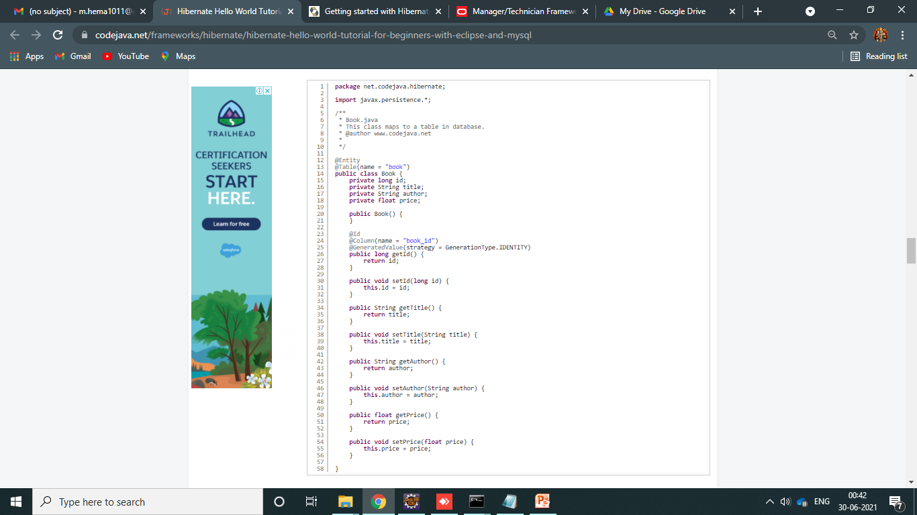
Pom.xml
Book.java

Slide 42
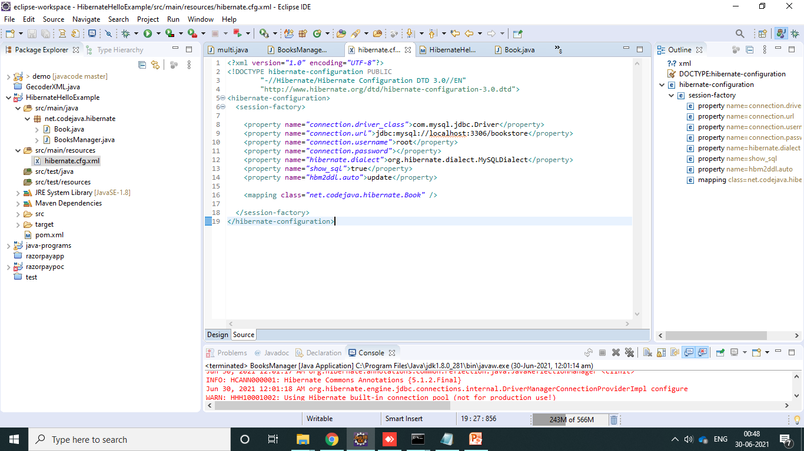
Create file :
Configure.cfg.xml
This is to configure database connectivity

Slide 43
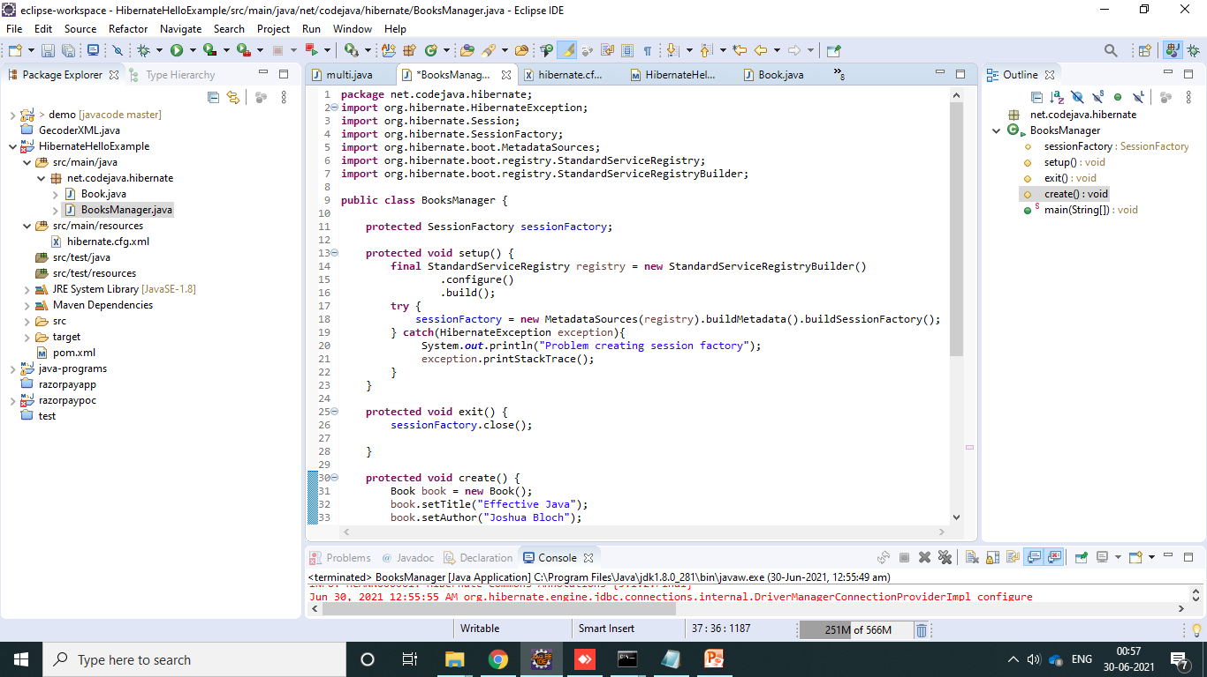
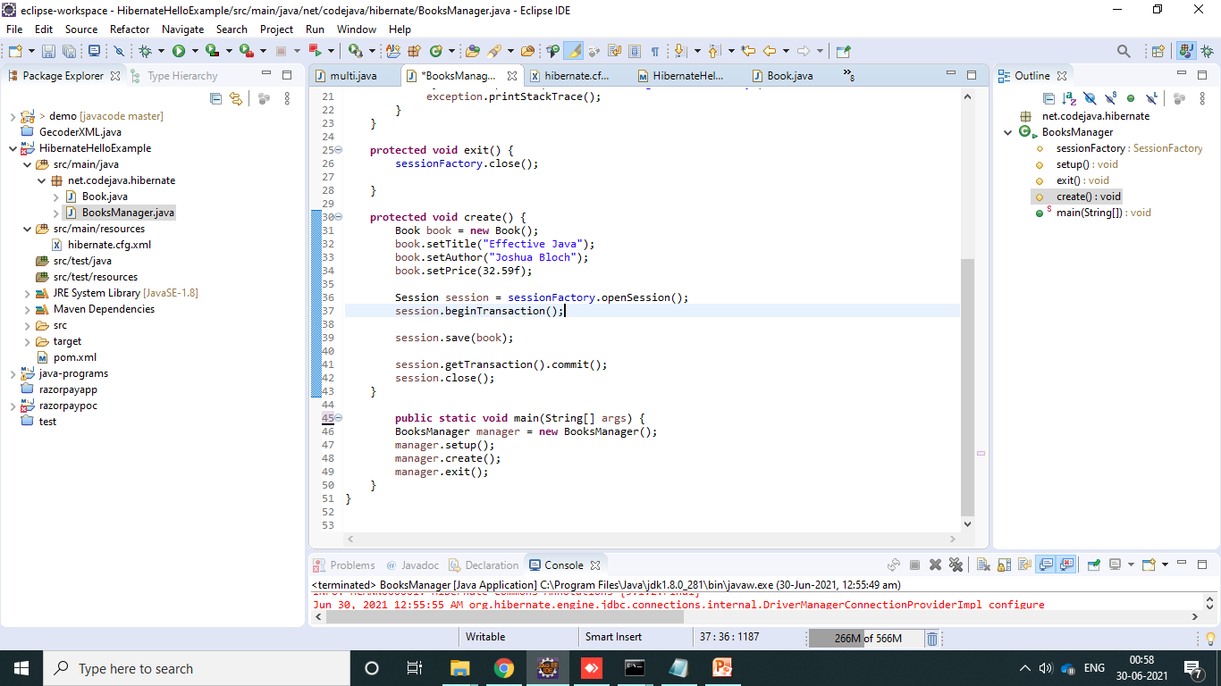
By using CRUD OPERATION ,we can implement CREATE Operation .
BookManager.java file
In this we can create Object and insert field values .
session .save(book)
It will directly store the data inside database

Slide 44
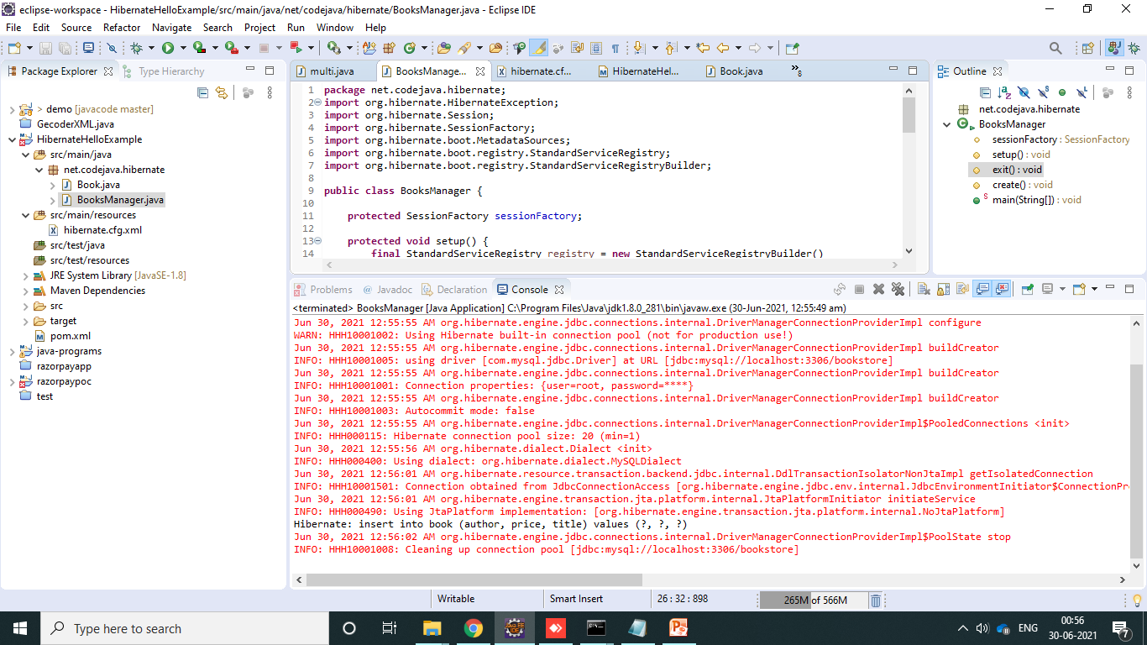
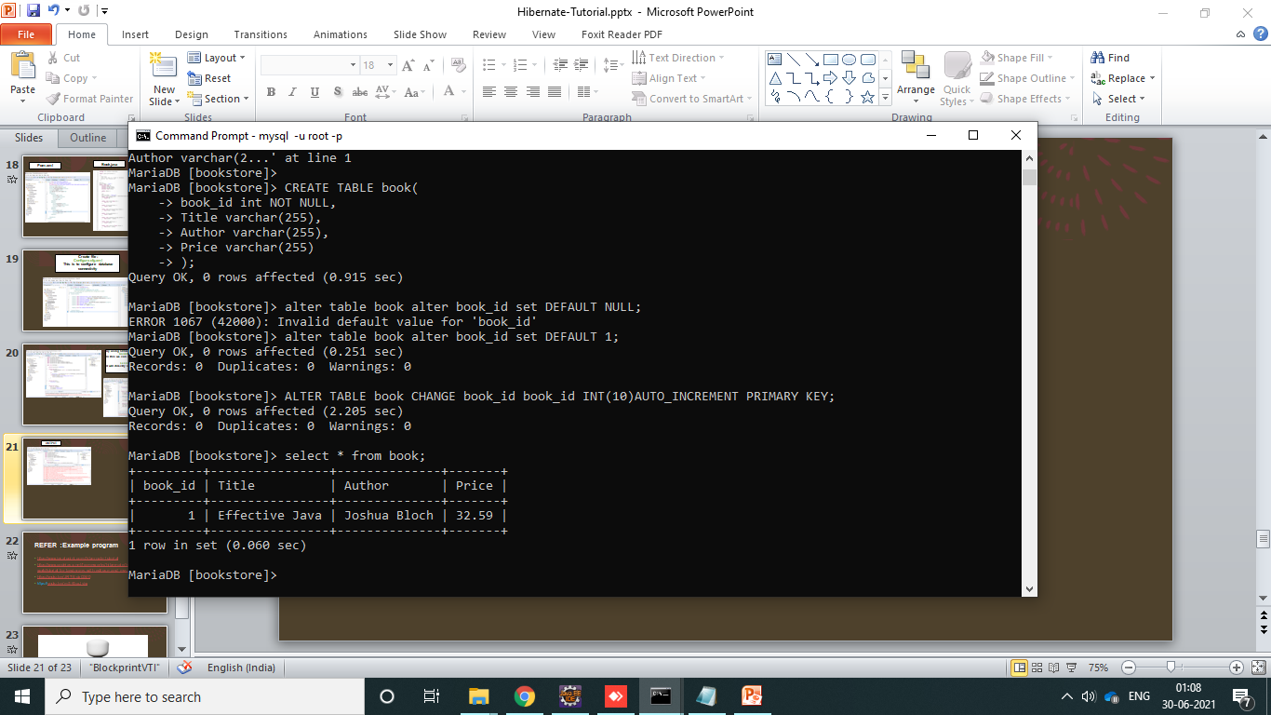
OUTPUT
Here in cmd :you can see the output that data are stored in book table

Slide 45
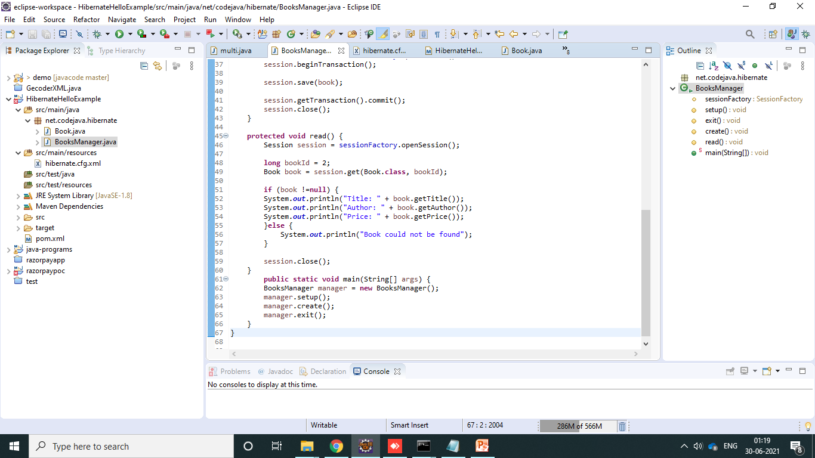
Implement READ Operation

Slide 46
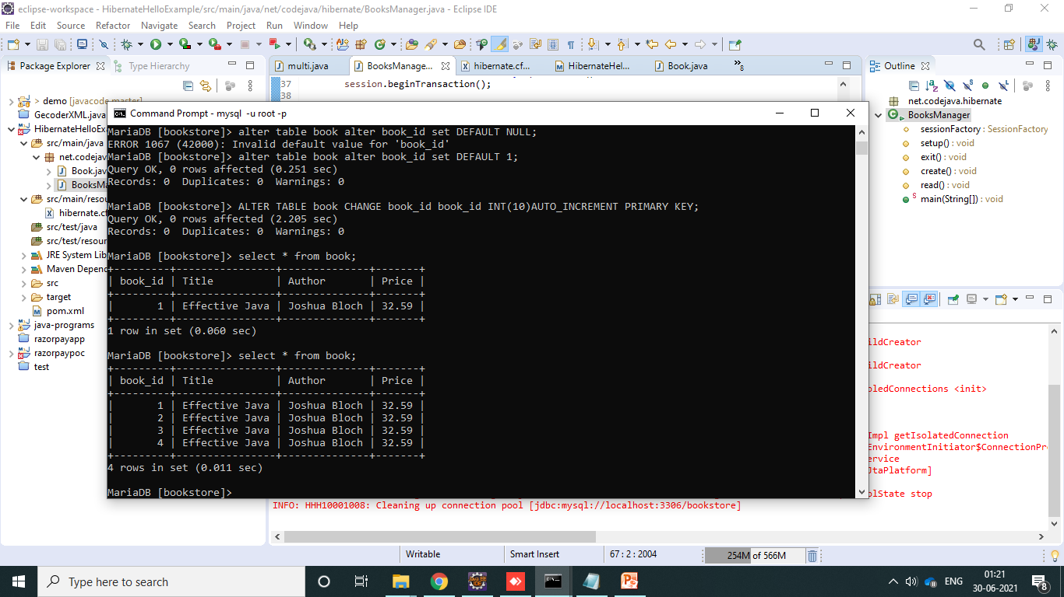
OUTPUT

Slide 47
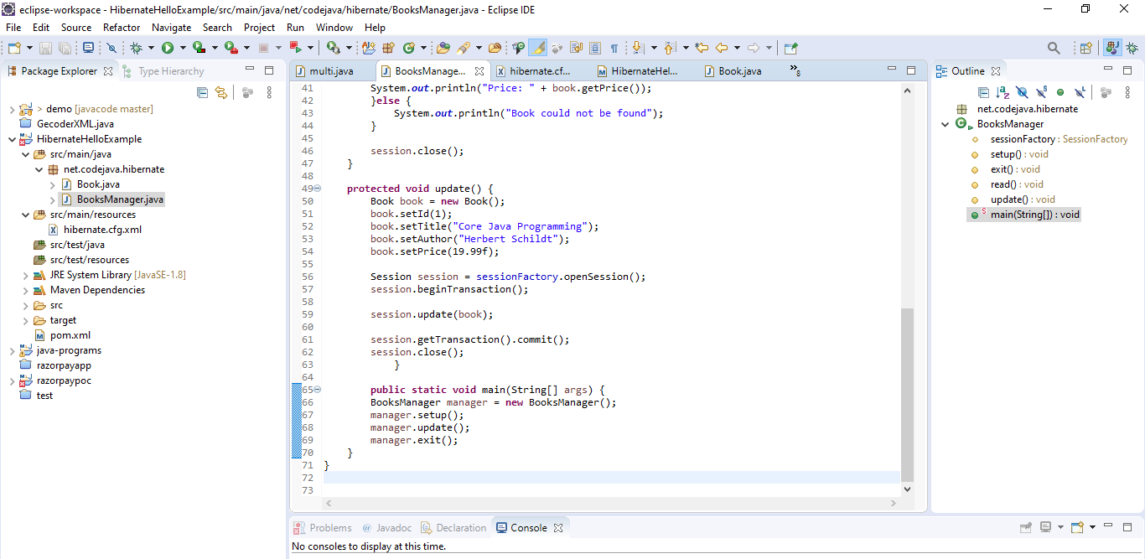
Implement UPDATE Operation

Slide 48
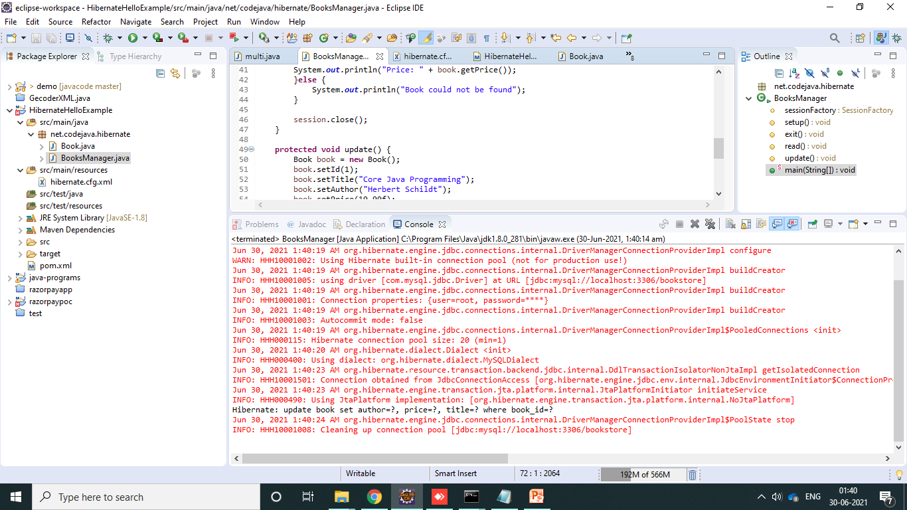
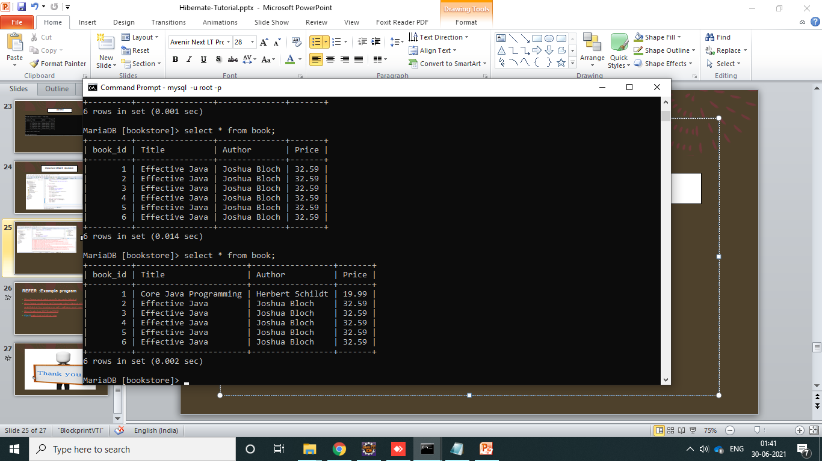
OUTPUT

Slide 49
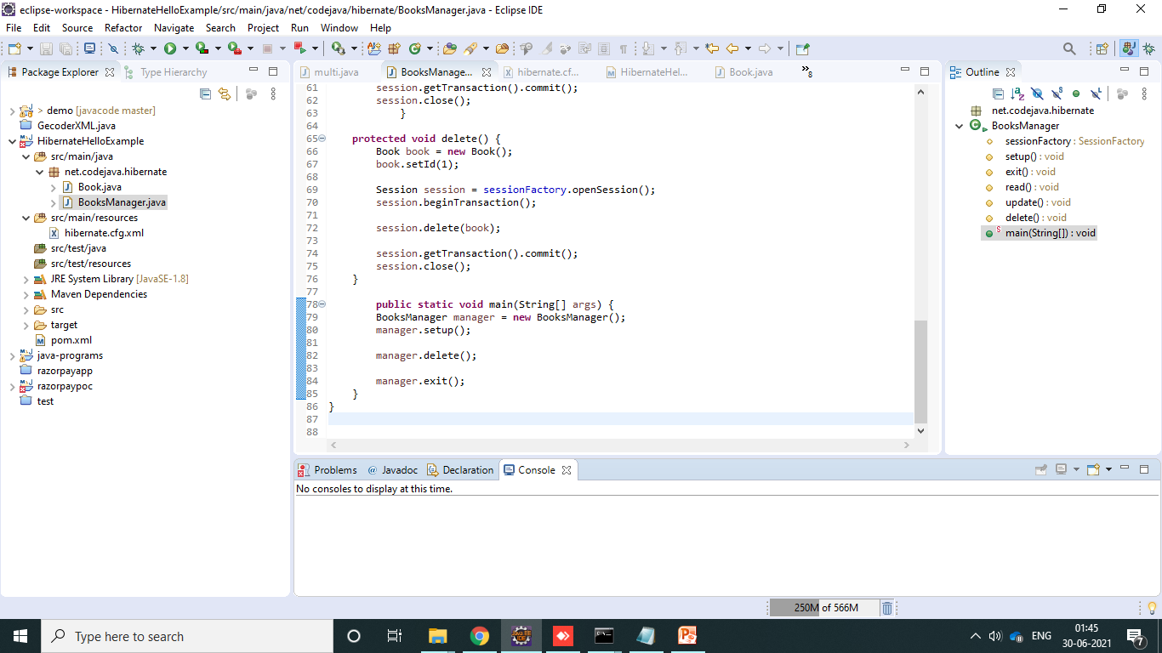
Implement DELETE Operation

Slide 50
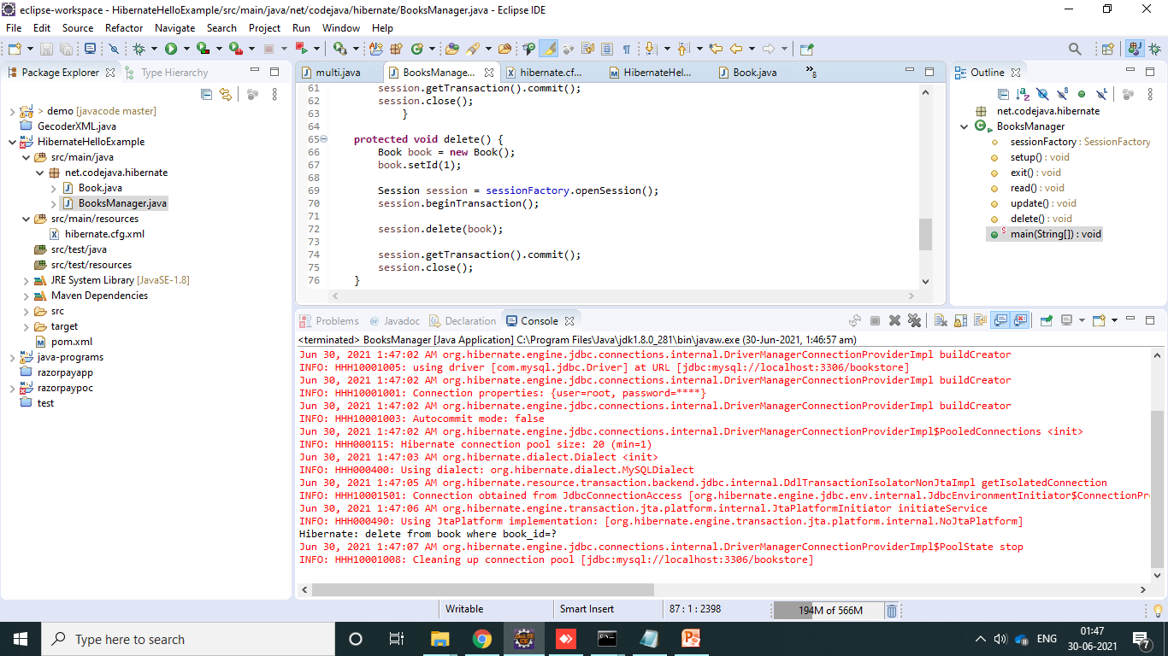
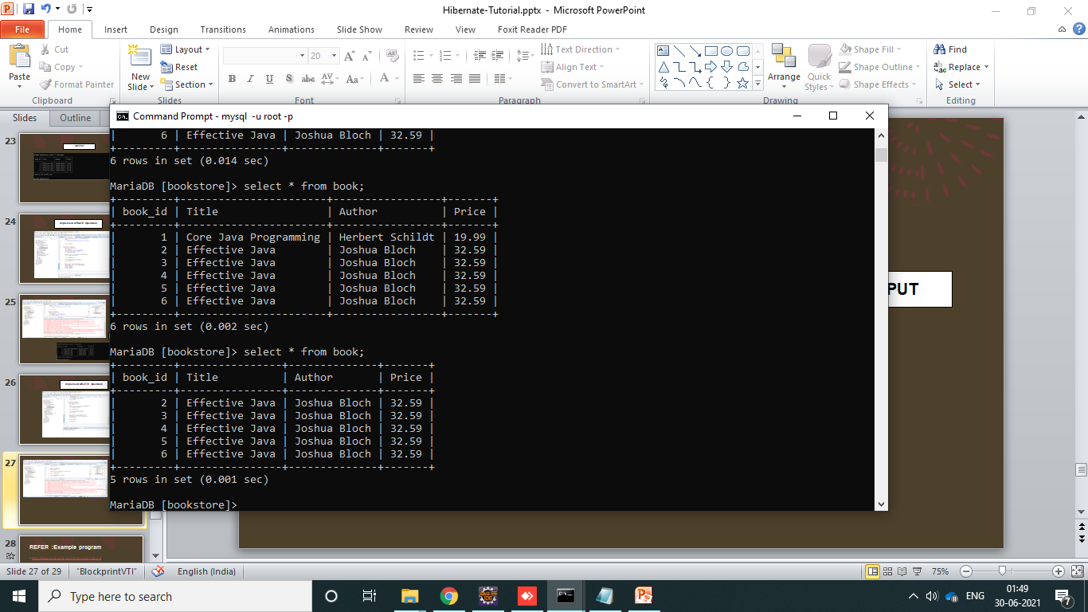
OUTPUT

Slide 51
REFER :Example program
https://www.javatpoint.com/hibernate-tutorial
https://hibernate.org/orm/documentation/getting-started/
https://www.codejava.net/frameworks/hibernate/hibernate-hello-world-tutorial-for-beginners-with-eclipse-and-mysql
https://youtu.be/JR7-EdxDSf0
https://youtu.be/m5-6IcxJviw

Slide 52


